Slide 1
Hibernate
By Robert Palmer

Slide 2
Introduction
To understand Hibernate, you have to understand:
JDBC – Java Database Connectivity
ORM – Object Relational Mapping

Slide 3
JDBC
It provides a set of Java API for accessing the relational databases from Java program
Enables program to executed SQL statements
Does the SQL coding for you

Slide 4
ORM
Programming technique for converting data between databases and object oriented programming languages
Hibernate is an Object Relational Mapping technique

Slide 5
The Connection
The ORM uses JDBC as an API to send and receive data to and from the database.

Slide 6
Sounds simple?

Slide 7
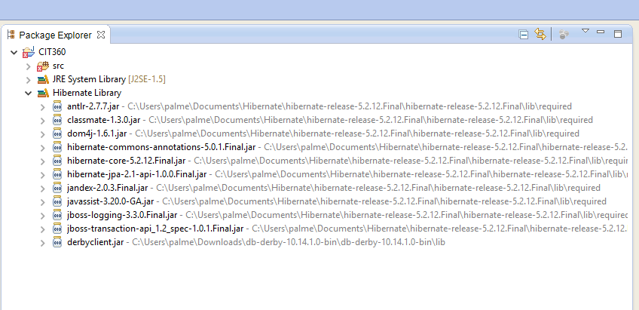
Here is just the basics
Hibernate is a library of jar files that must be installed on your computer

Slide 8
Also….choose a database to also install
MySQL
Microsoft SQL Server
Oracle Database
IBM Db2
PostgreSQL
And many more………

Slide 9
Eclipse
Database
Hibernate Library
Hibernate.cfg.xml
Hibernate

Slide 10
That was just the setup!

Slide 11
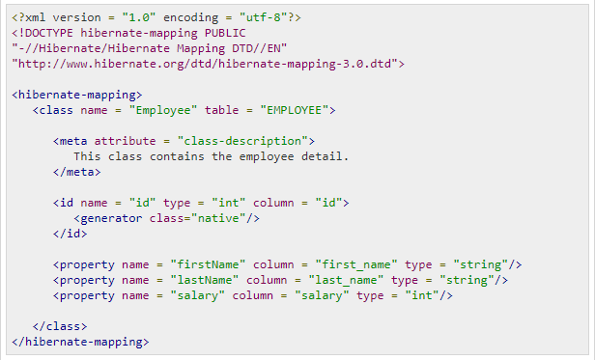
Now we code
Using something similar will is a start to configuring
This is your hibernate.cfg.xml file

Slide 12
Resources
https://www.tutorialspoint.com/hibernate/index.htm
https://www.javatpoint.com/hibernate-tutorial
https://www.journaldev.com/3793/hibernate-tutorial
https://www.youtube.com/watch?v=GINvxAaXDbY (Watch the series to get a better understanding?)

